Slide 1

Loan Approval Prediction Using Machine Learning
Presented by: Shamnas K
Predicting loan approval status using classification algorithms to support data-driven lending decisions.

Slide 2
Project Overview
Problem Statement
Banks receive many loan applications and require a reliable, consistent method to decide approval eligibility at scale.
Objective
Develop a classification model that predicts Loan_Status (Y/N) using applicant demographics, financials and credit history.
Expected Outcome
A validated model to assist underwriting teams and reduce manual review workload while improving decision consistency.

Slide 3
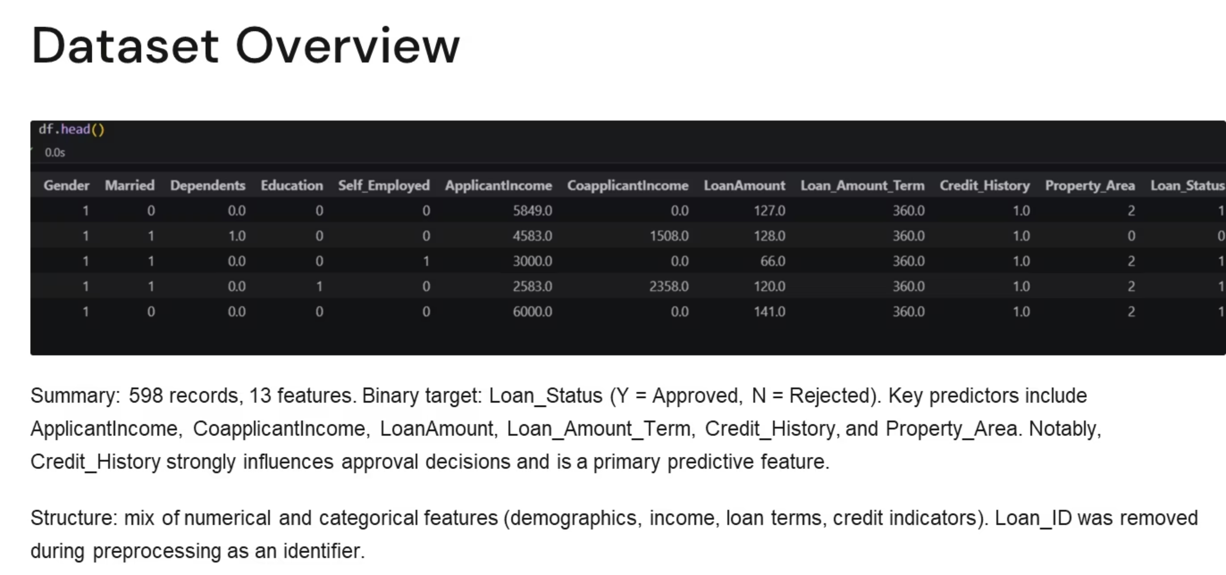

Slide 4
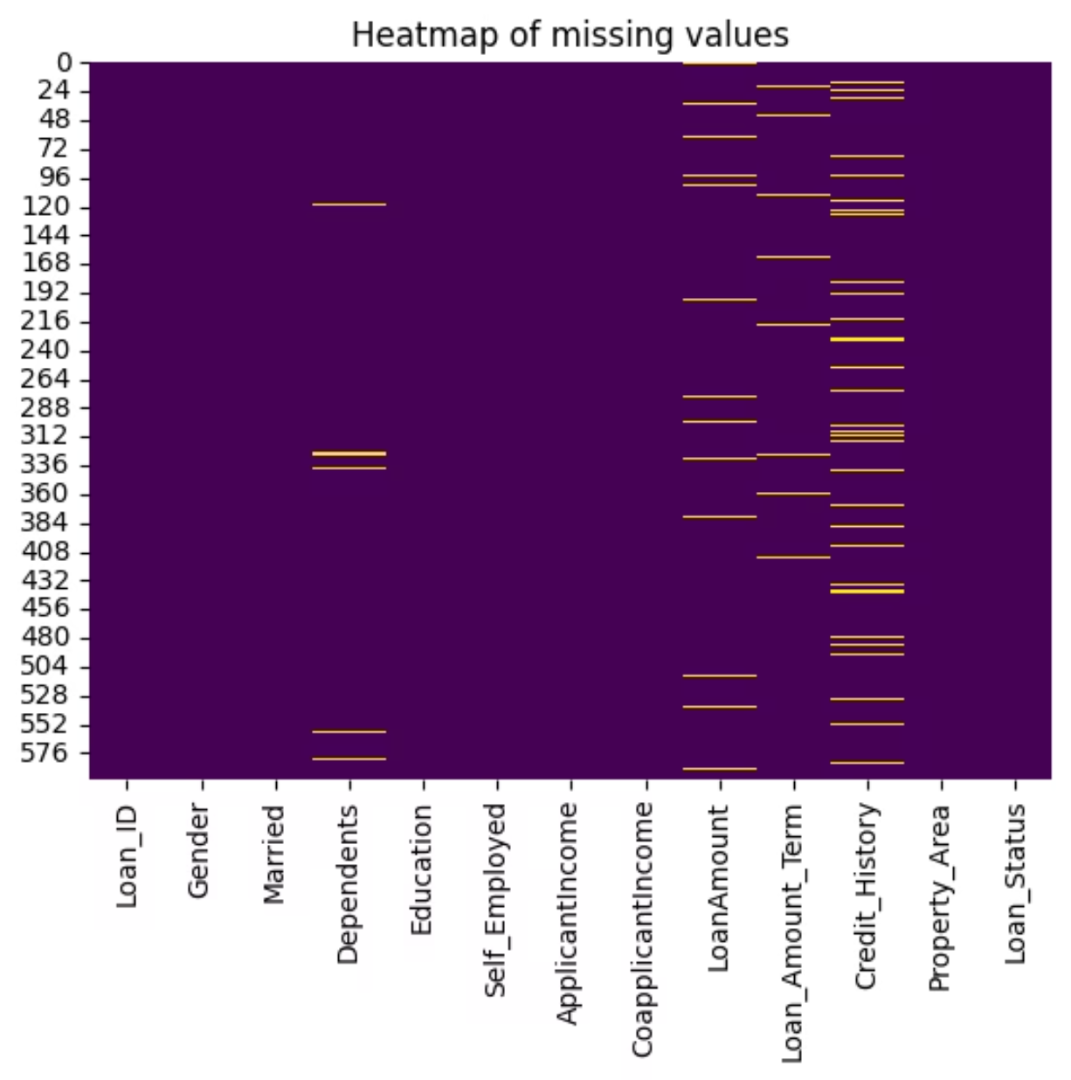
Data Exploration & Missing Values
Shape: 598 × 13
Feature types: Mix of numerical and categorical variables (see dataset overview).
Missing value findings
Missing in: Dependents, LoanAmount, Loan_Amount_Term, Credit_History
No missing values in many categorical fields (e.g., Gender, Married) after initial inspection
Imputation strategy
Median imputation for numerical fields: Dependents, LoanAmount, Loan_Amount_Term
Mode imputation for Credit_History
The heatmap and count summary guided targeted imputation to preserve distributional characteristics.

Slide 5

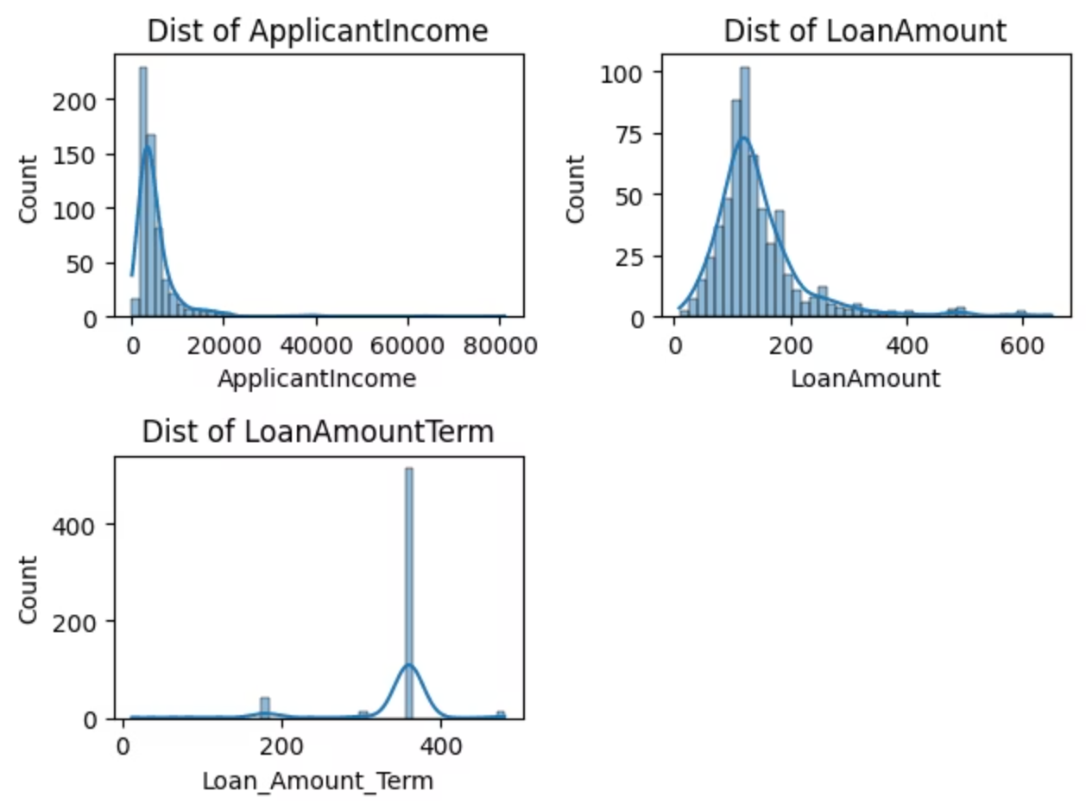
Exploratory Data Analysis Distributions
Single visual summarising distributional patterns:
ApplicantIncome and LoanAmount are right-skewed with extreme values.
Most applicants choose a loan term of 360 months.
Skew and extremes informed later outlier handling and transformation choices.

Slide 6
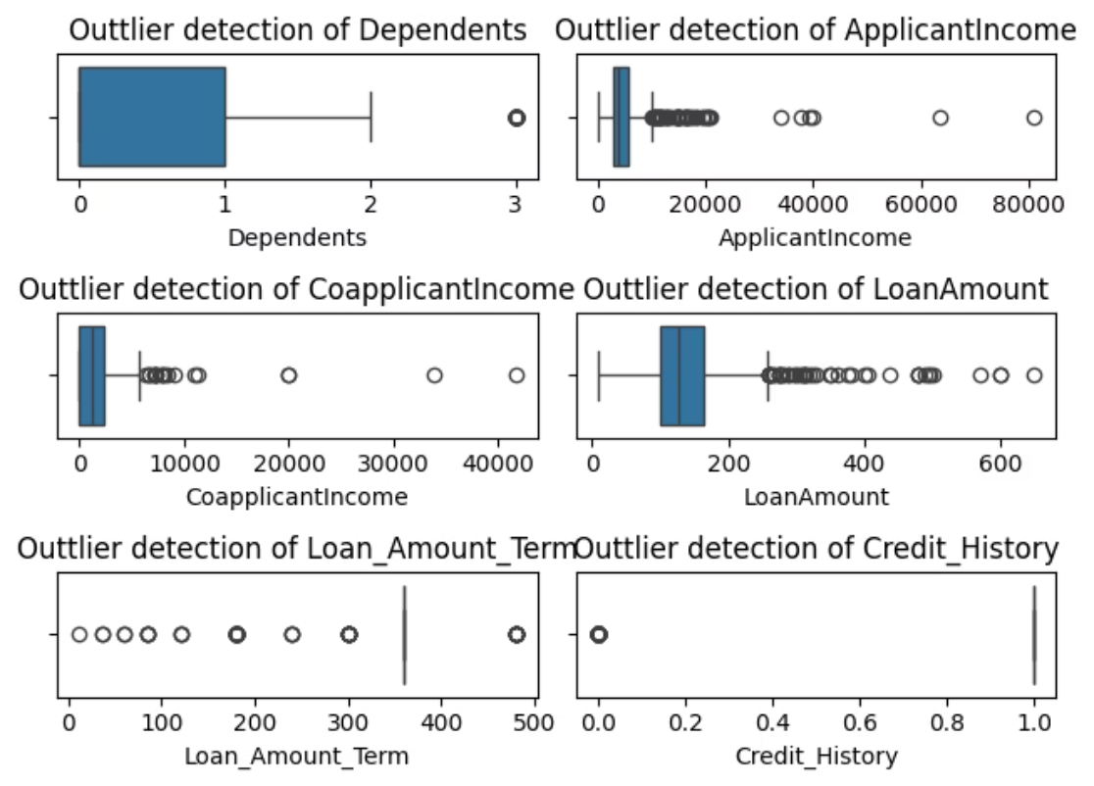
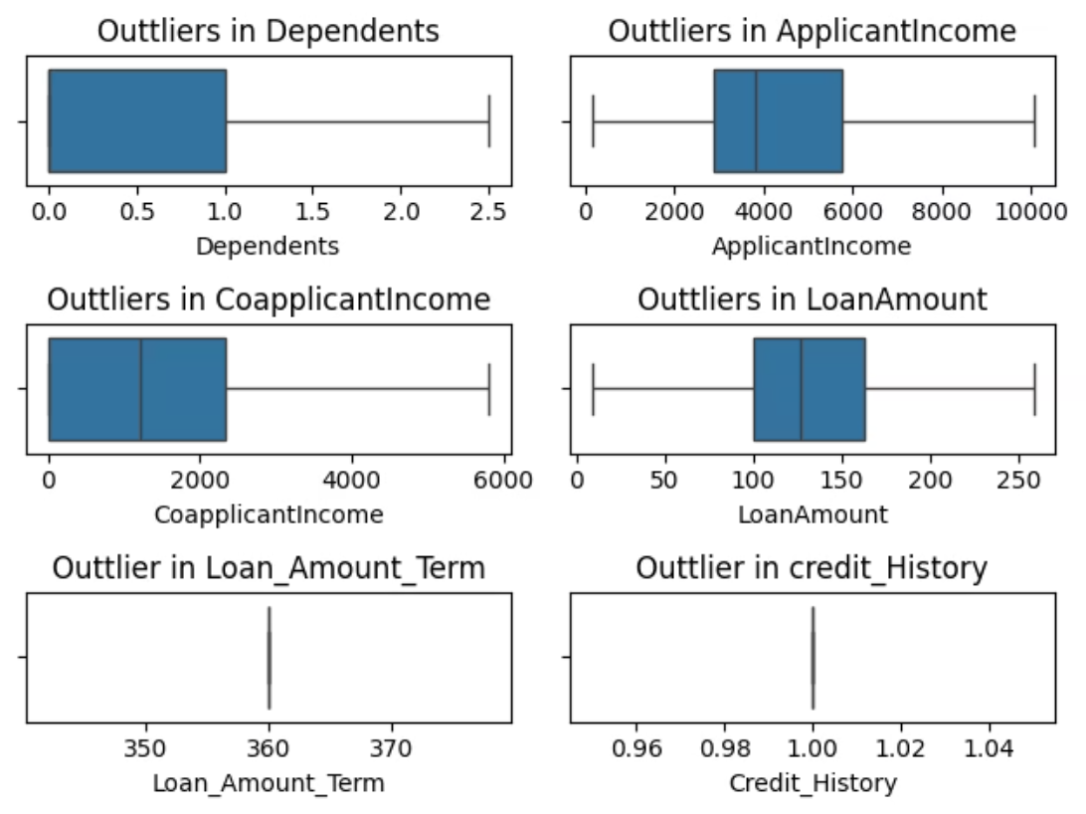
Outlier Analysis & Treatment
BOXPLOT - Before
BOXPLOT - After
Features with outliers: ApplicantIncome, CoapplicantIncome, LoanAmount.
IQR-based capping was applied to bound extreme values rather than remove records — preserving sample size while reducing undue influence.

Slide 7
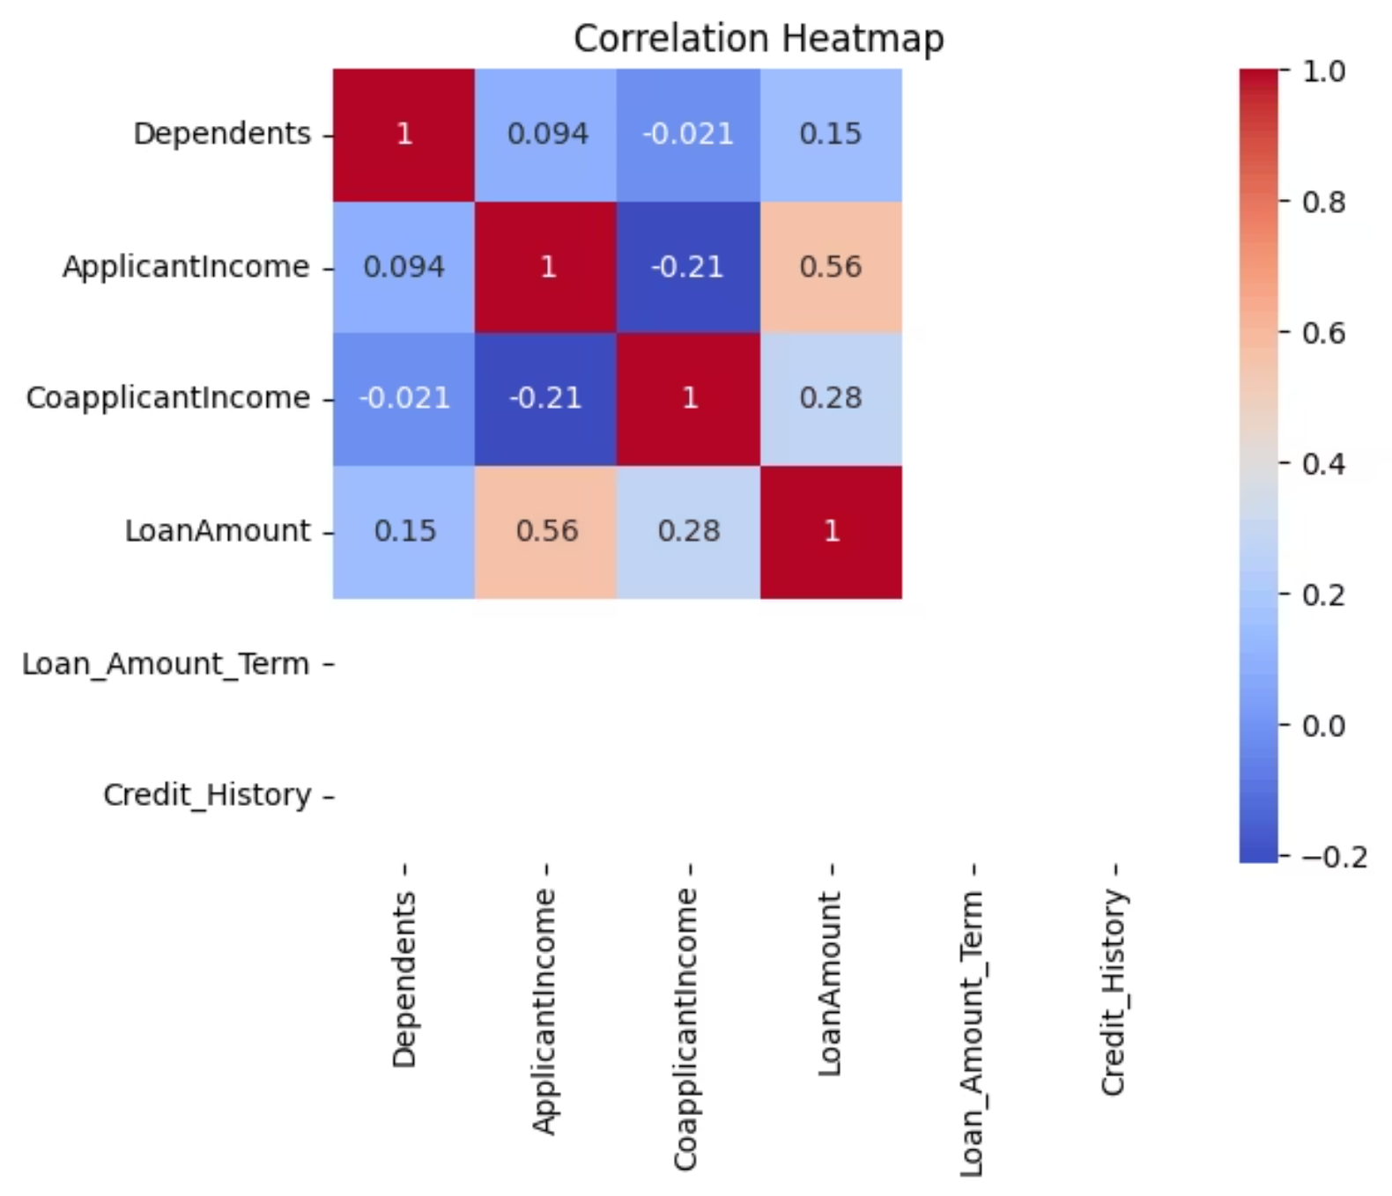
Correlation & Feature Engineering
—> Key findings
ApplicantIncome and LoanAmount show the strongest positive correlation.
Overall low multicollinearity across most features.
Feature engineering & preprocessing
Removed: Loan_ID (identifier)
Label encoding for categorical variables
Standard scaling for numerical features
Train-test split: 80:20
Target imbalance (Y:411, N:187) → Random oversampling applied to training set

Slide 8





Model Training
Logistic Regression
K-Nearest Neighbours (KNN)
Random Forest
Baseline linear classifier for probability estimates.
Instance-based classifier sensitive to scaling.
Ensemble tree-based model for non-linear relationships.
Naive Bayes
XGBoost
Probabilistic baseline assuming conditional independence.
Gradient-boosted trees — strong performer for tabular data.
Predictions from each model were evaluated with accuracy, precision, recall and F1; resampling and scaling applied consistently across pipelines.

Slide 9
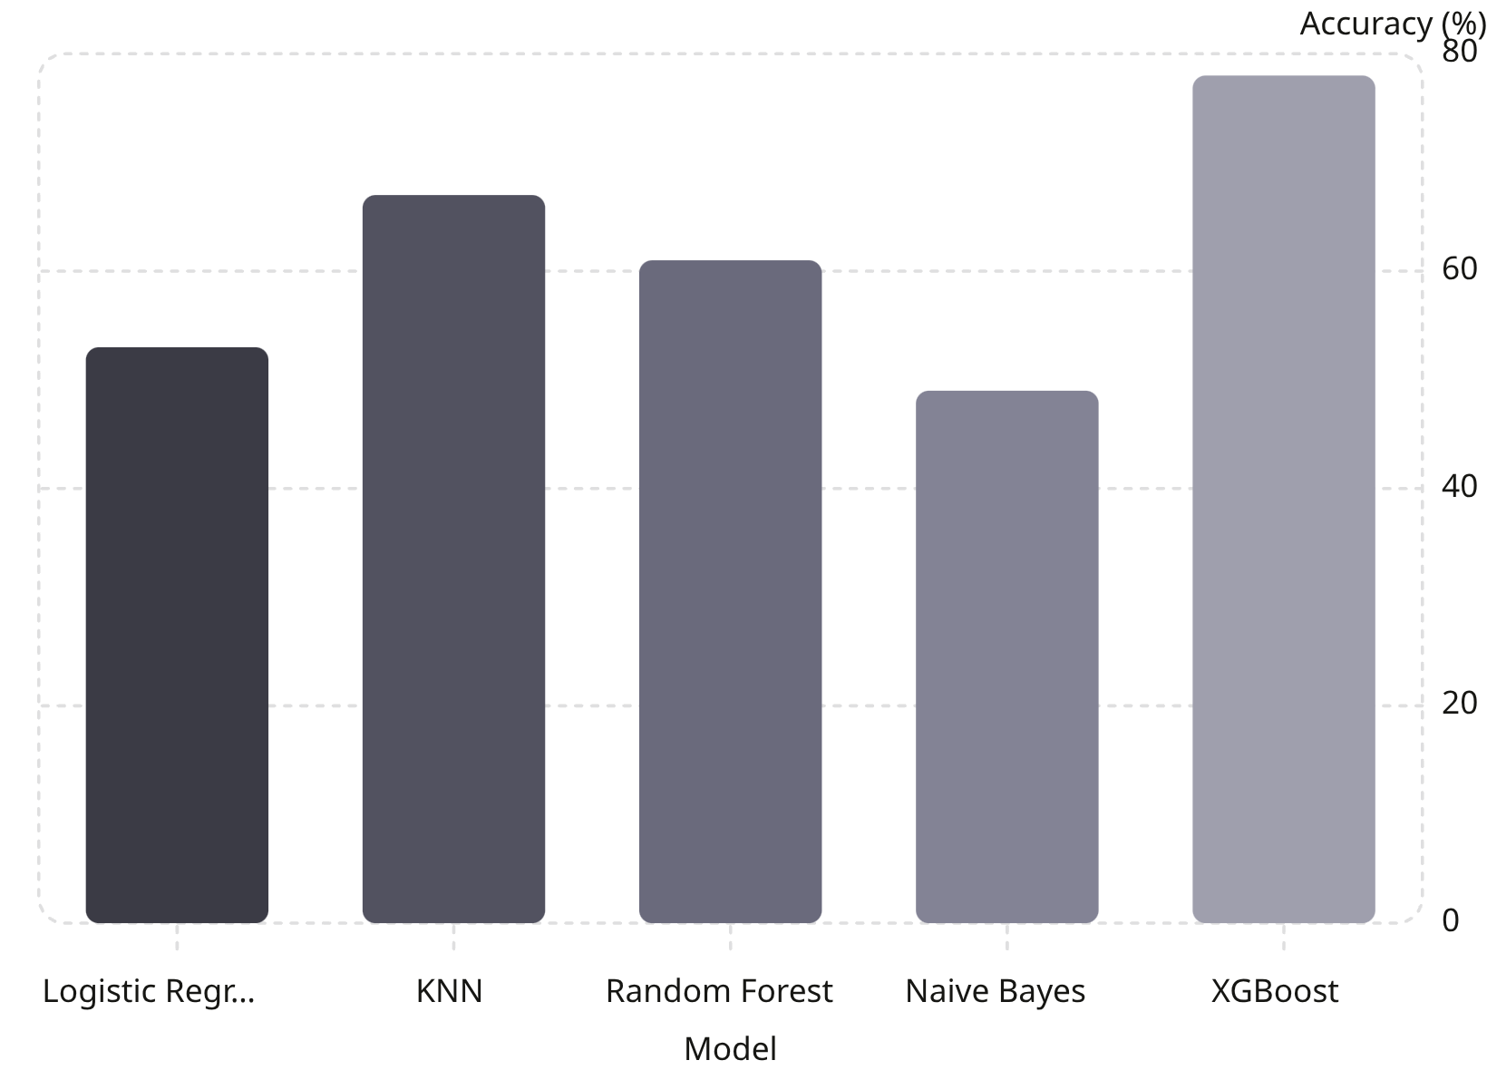

Model Evaluation & Comparison
Key observations
XGBoost leads on accuracy (78%) and dominates precision, recall and F1.
KNN and Random Forest show moderate performance; Logistic Regression and Naive Bayes lag.
Oversampling improved recall for the minority class, benefiting tree-based models.
Final selection: XGBoost chosen for hyperparameter tuning due to superior balanced metrics.

Slide 10
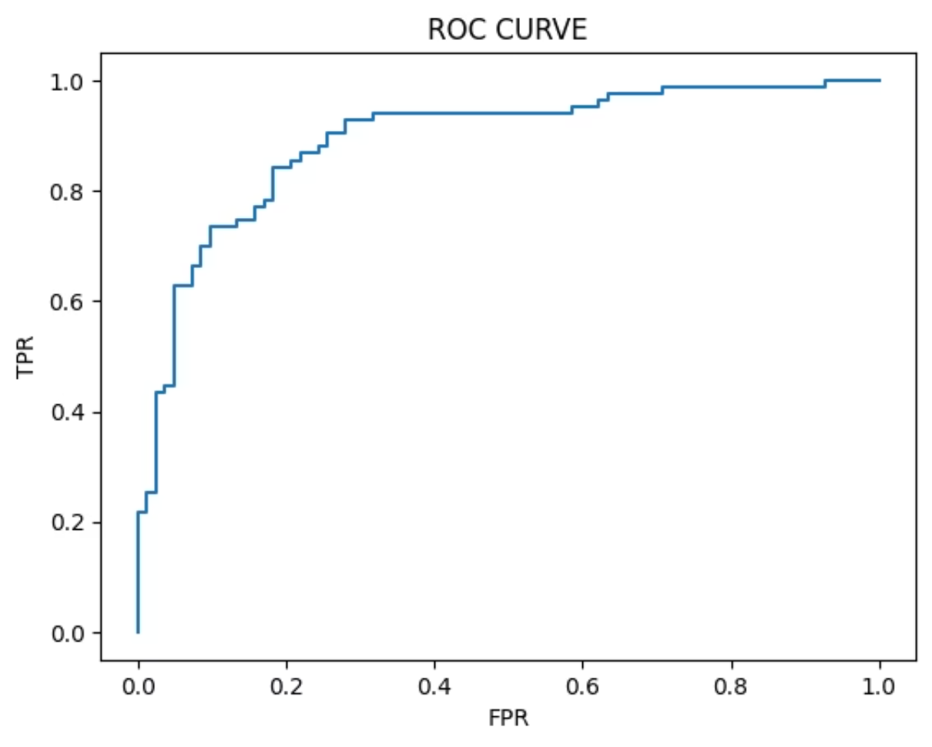
Final Model & Conclusions
XGBoost is the final model
Hyperparameter tuning
GridSearchCV with 5-fold CV. Best parameters: learning_rate=0.1, n_estimators=200.
Final performance
Accuracy: 81%
AUC: 0.89
Best precision, recall, and F1 among tested models
Conclusions
Developed a robust classifier for loan approval decision support.
Systematic cleaning, imputation, outlier capping and resampling were critical to model performance.
XGBoost with tuned hyperparameters provided the strongest predictive capability.
Thank you. Questions welcome.

